Slide 1
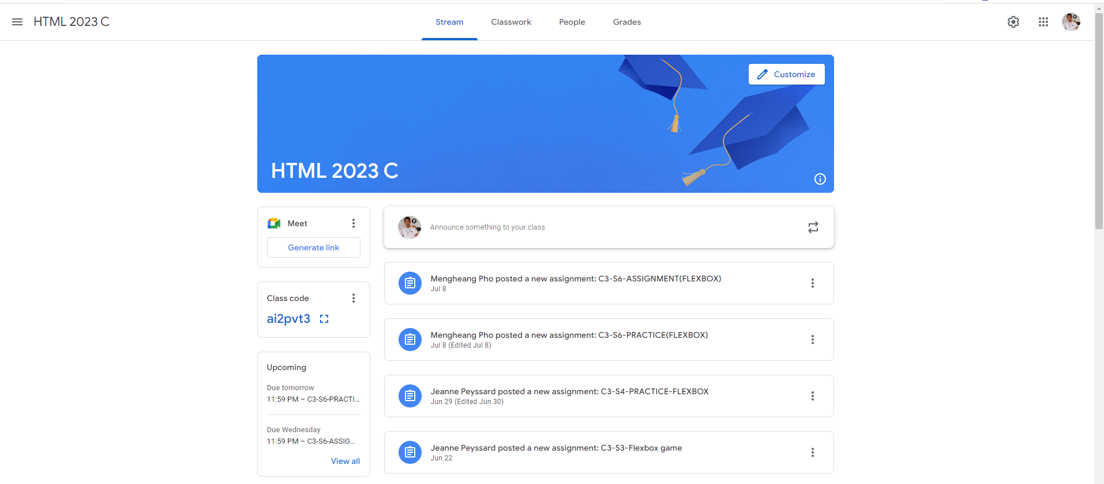
Identify root components of website below

Slide 2
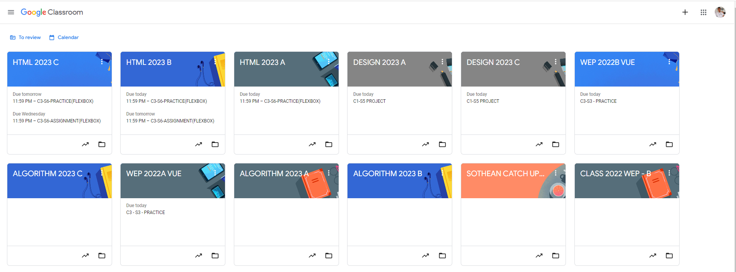
Root div
- Height: 100vh
content
nav
Flex: 0
header
Flex: 0
Flex: 1

Slide 3
Root div
- Height: 100vh
Flex direction: column, flex grow 1
Navigation bar
Header – class
information
Flex grow 1
Flex direction: row
Content – class
materials
Flex grow 2
Flex direction : row

